Slide 1

Exploratory Data Analysis (EDA) on AMEO Dataset
Muhammed Mustafa Shaik
IN1240812

Slide 2


About me
I’m holding a Bachelor's degree in Computer Science and Engineering, where I developed a strong foundation in programming, algorithms, and software development, I have an experience of 1.2 years as programmer, I have a very keen interest in software development and always open to learn and explore new technologies.
I've always been fascinated by the power of data to solve complex problems and drive decision-making. This interest has led me to dig deeper into data science, exploring topics such as machine learning and big data analytics. To further my career and align with my interests, I am eager to learn more about data science, particularly in areas like predictive modeling and data visualization. My goal is to leverage my programming background and new data science skills to develop innovative data-driven solutions.

Slide 3
Objective of the Project:
This project is all about the Aspiring Mind Employment Outcome (AMEO) data which was surveyed in 2015 and we need to perform Exploratory Data Analysis (EDA) on this data considering SALARY as the target variable and should analyze the data and mark the observations
Summary of the Project:
This dataset contains multiple columns having numerical columns as well as categorical columns, as well as there are some dependent variables like Salary, Job Titles, Locations and is has about 4000 rows and 39 columns.

Slide 4
Data Cleaning Steps:
As we all know the first step is loading the data set and importing the necessary packages
import pandas as pd
import numpy as np
import matplotlib.pyplot as plt
import seaborn as sns
from scipy.stats import norm
Next, we need to display the head, shape, and info of the dataset given
df.head()
df.shape()
df.info()
We need drop the unnecessary columns like unnamed , ID and convert the DOL and DOJ into datetime format
df_data = df_data.drop(columns = ['Unnamed: 0'])
df_data['DOL'] = pd.to_datetime(df_data['DOL'])
df_data['DOJ'] = pd.to_datetime(df_data['DOJ'])
We need to find the numerical columns and categorical columns in the dataset
cat_variables = ['Designation','JobCity', 'Gender','10board','12board','CollegeTier','Degree','Specialization','CollegeCityTier','CollegeState']
for categoryvar in cat_variables:
df_data[categoryvar]=df_data[categoryvar].astype('category')

Slide 5
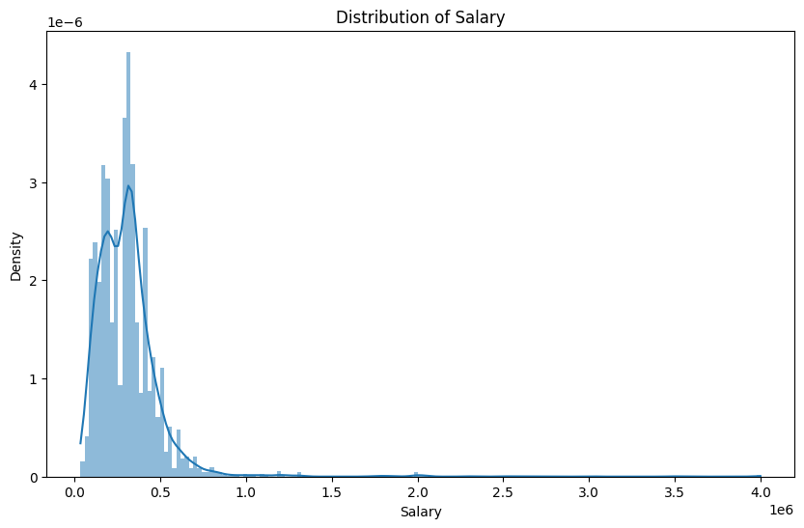
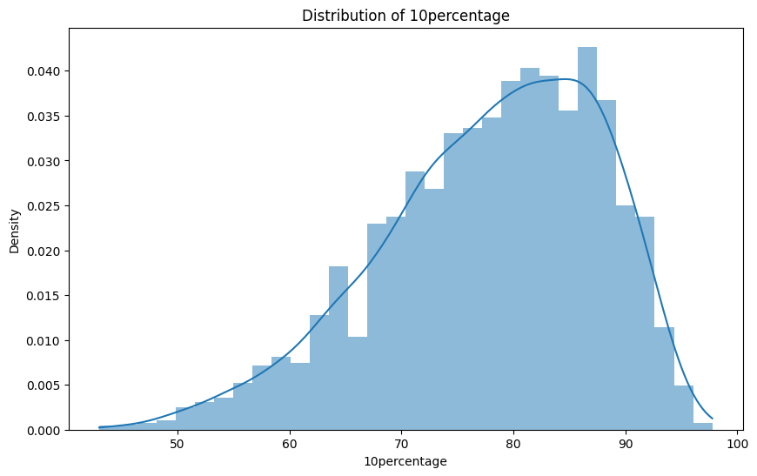
Data Analysis Steps:
In Data Analysis Steps we are going to perform Univariate Analysis and Bivariate Analysis on different columns like Salary, CollegeID, CollegeGPA etc..
The above graph represents the distribution of Salary
This graph is a left skew
The above graph represents the distribution of !0th Class Percentage

Slide 6
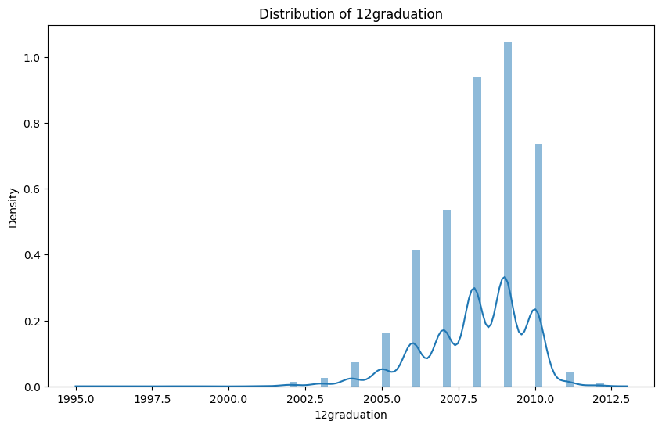
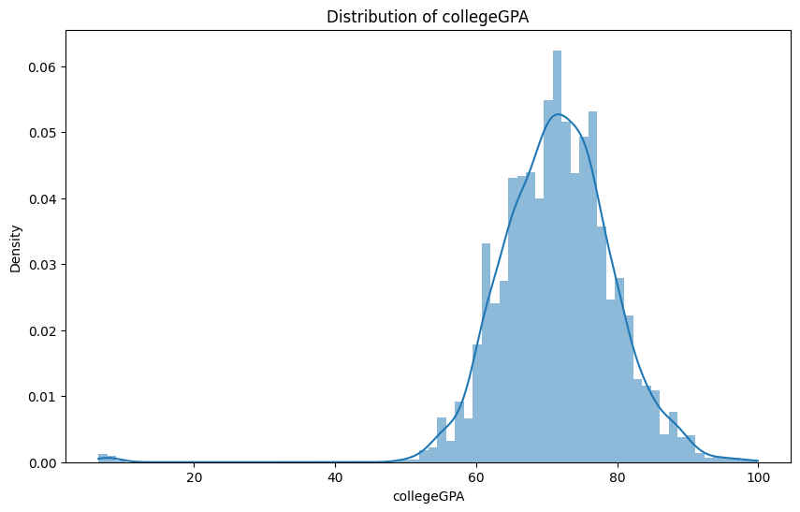

Slide 7
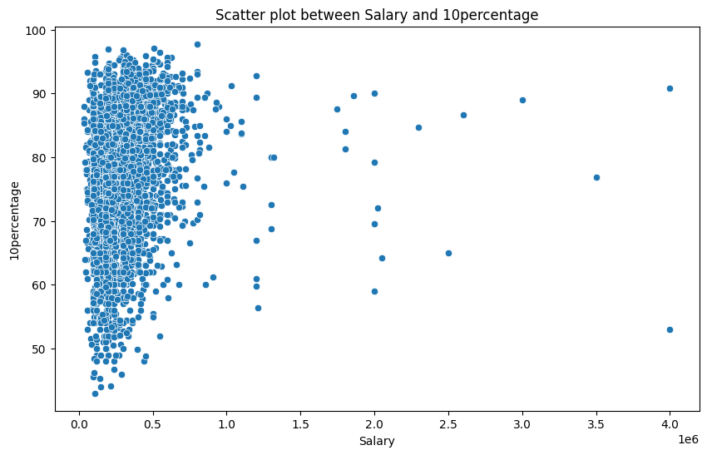
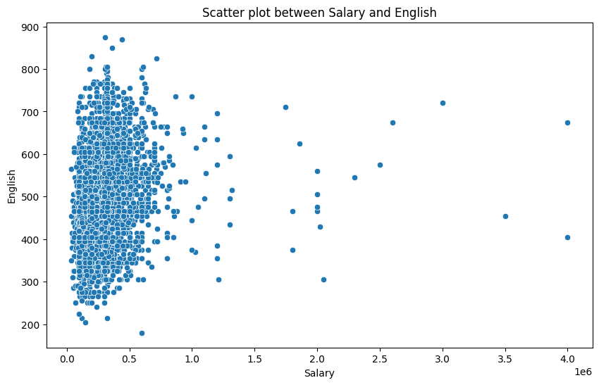
Bivariate Analysis:

Slide 8
Research Question:
Times of India article dated Jan 18, 2019 states that “After doing your Computer Science Engineering if you take up jobs as a Programming Analyst, Software Engineer, Hardware Engineer and Associate Engineer you can earn up to 2.5-3 lakhs as a fresh graduate
As stated by the Times of India Article dated Jan18th, 2019 that the average salary is2.5-3 Lakhs but in our analysis it states that their maybe more than 3 Lakhs
These Analysis provide overall insights to analyze the valuable information targeting the Salary Variable with the other columns in the dataset

Slide 9
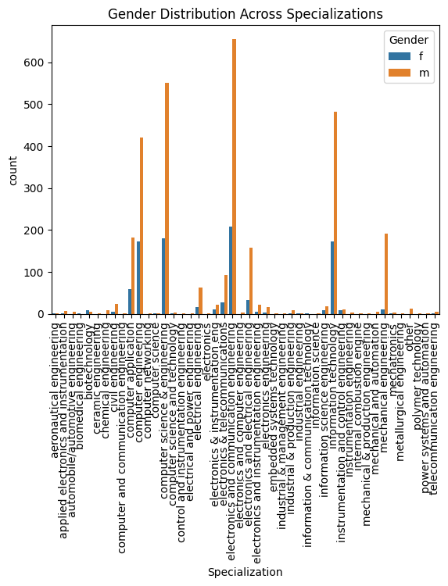

Is there a relationship between gender and specialization?
This analysis is done by using the chi square test value
In this Analysis we got chi square test value as 6.8
A low p-value (typically <0.05) would suggest that there is a statistically significant relationship between gender and specialization, indicating that the preference for specialization depends on gender.

Slide 10
Conclusion:
By this Data Analysis we can conclude that Gender has no co-relation with the distribution of salary and Academic performance also doesn’t play a major role in the salary of the employee.
However, tenure and college tier plays a deciding factor for the compensation of salary across associates.

Slide 11

ANY QUERIES?
THANK YOU

